Slide 1
Info
A SETAC Europe training course on landscape modelling has so much potential to be engaging, playful, and genuinely memorable — especially because the topic sits at the intersection of ecology, spatial thinking, and systems dynamics. People learn landscape modelling best when they can see, touch, and experiment with the concepts, not just listen to slides.
Start with a study question: Pyrethroid aquatic RA,
Ways to Make a Landscape Modelling Course Engaging
1. Start with a “Landscape Modelling Escape Room”
Participants solve a series of small modelling puzzles to “unlock” the next step.
Identify land‑use classes from a simplified map
Run a tiny model to see which parameter is wrong
Interpret a landscape metric to find a hidden clue
Decode a SORA‑style risk map to “escape”
It sets the tone: playful, collaborative, and hands‑on.

Slide 2
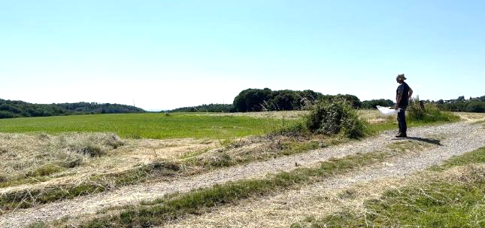

Welcome
I’m Thorsten Schad thorsten.schad@landwerk-ev.de
Biologist, with a background in math and informatics
27+ years in environmental and landscape modelling, esp. in risk assessment of pesticides
Co-creator of xLandscape
Passionate about balancing human welfare, natural resources and biodiversity

Slide 3
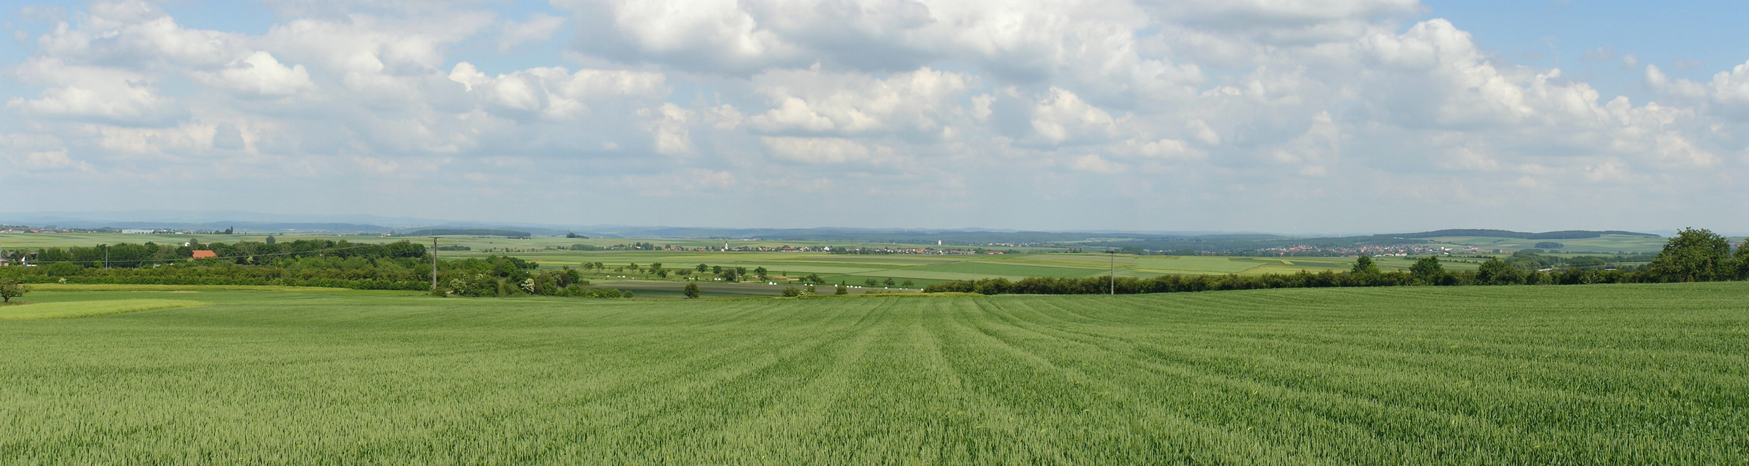

AI: "A SETAC Europe training course on landscape modelling has so much potential to be engaging, playful, and genuinely memorable, especially because the topic sits at the intersection of ecology, spatial thinking, and systems dynamics. People learn landscape modelling best when they can see, touch, and experiment with the concepts, not just listen to slides." (Copilot March’26)
Wetterau, Hessian, Germany
Notes:
(at least, get more interested)

Slide 4
We want to create value for your project
Understand the principles of landscape-level ecological risk assessment
Introduction to the xLandscape framework - motivation, concepts, design
Apply xLandscape models - aquatic organisms, water plants, and pollinators and evaluate the results of landscape-level simulations
!Learn about the motivation and application of landscape modelling! and perhaps, you might get exited about it
We cannot make you a xLandscape modelling expert today → contact us!
Wetterau, Hessian, Germany
Notes:
(at least, get more interested)

Slide 5
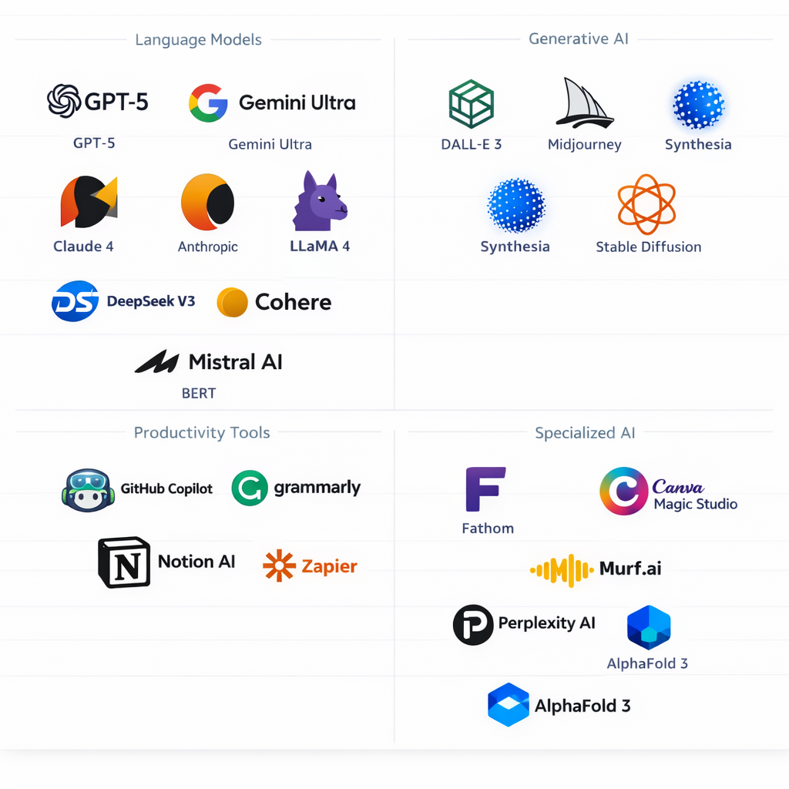

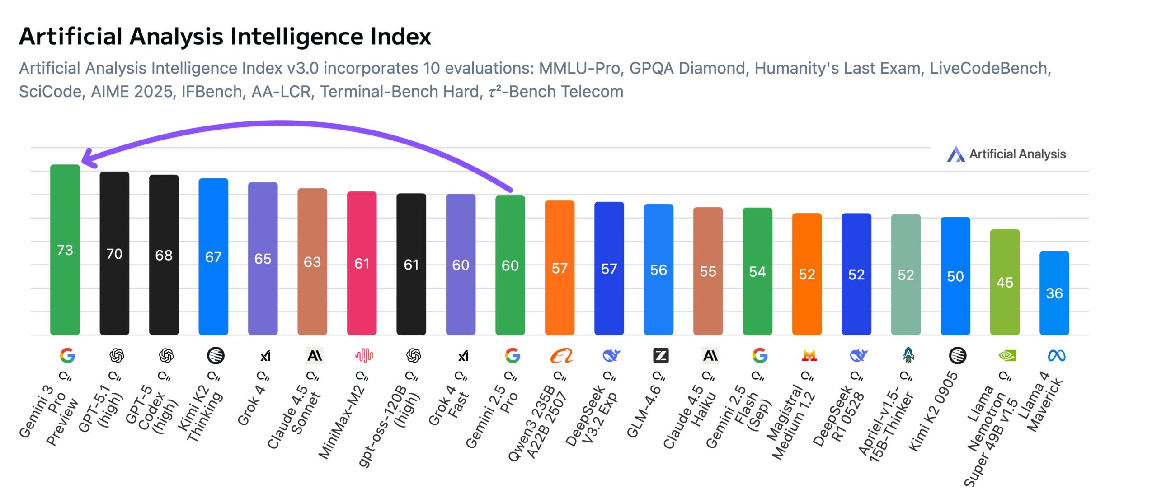
The Rise of AI
A game changer! affecting,
xLandscape development (core, components, models)
Analysis, visualization, report of results
User Interface, GUI, Web
Scenario development
Documentation, Training
Less affected: regulatory and conceptual framework
We are embracing and adapting to AI! considering dependencies, robustness and continuity →in progress
Wetterau, Hessian, Germany
Notes:
(at least, get more interested)

Slide 6
The Rise of AI
→Consequences. Training focal take home:
Motivation for Landscape Modelling
Regulatory framework. Strategies. Risk Management
Concepts, esp. modularity. Model architectures.
Model Results. Communication. Evaluation.
Current and future range of application.
less: technical realization, usability (UI) (might change)
Contact: thorsten.schad@landwerk-ev.de
Wetterau, Hessian, Germany
Notes:
(at least, get more interested)

Slide 7
Content 13.30 – 17.30
13:30 - 13:50 | Introduction and Fundamentals What's meant by landscape-level risk assessment | Thorsten
13:50 - 14:15 | Introduction to xLandscape Motivation, concepts, design | Thorsten, Sascha
14:15 - 15:15 | Aquatic Risk of Invertebrates A real-world risk assessment problem for the use of an insecticide | Thorsten
15:15 - 15:30 | Coffee Break
15:30 - 16:30 | Aquatic Risk of Water Plants A real-world risk assessment problem for the use of a herbicide | Sebastian
16:30 - 17:15 | Pollinators Risk assessment and management for honey bees | Julian, Sascha
17:15 - 17:30 | Wrap-up, Q&A, Outlook | all
Invitation to contact me after the course → thorsten.schad@landwerk-ev.de
Wetterau, Hessian, Germany
Notes:
(interactive talk, questions, quiz)
(interactive RA problem, analsis, model run, questions, quiz)

Slide 8
TC06 SETAC Announcement
TC06: Hands-on Landscape-Based Ecological Risk Assessment Using the Open-Source xLandscape Modelling Framework
Time: 13:30—17:30, Room: TBD, Course level: Introductory
This course will provide participants with a comprehensive introduction to landscape-level ecological risk assessment using the modular, open-source xLandscape framework. Participants will learn how to apply existing xLandscape models for exposure and effect modeling, as well as how to develop new components for the system. xLandscape is a modular, flexible, and transparent framework for spatiotemporally explicit landscape modeling. It allows for the integration of various data sources and models to simulate complex environmental processes at the landscape level. The course will cover: • The fundamentals of landscape-level risk assessment. • The component-based software architecture of xLandscape. • The application of models for Aquatic Risk, Water Plants, and Pollinator Risk. • Hands-on exercises in applying xLandscape to real-world case studies.
Learning Objectives and Outcomes
Upon completion of this course, participants will be able to:
Understand the principles of landscape-level ecological risk assessment.
Describe the architecture and capabilities of the xLandscape framework.
Apply existing xLandscape models to assess risk to aquatic organisms, water plants, and pollinators.
Critically evaluate the results of landscape-level simulations.
Target Audience
This course is designed for a broad audience of environmental scientists, including students, academic researchers, industry professionals, and regulatory scientists, who are interested in landscape-level ecological risk assessment. A basic understanding of environmental modeling and risk assessment is recommended, but no prior experience with xLandscape is required.
Instructors
Thorsten Schad (Freelancer), Sascha Bub (Rheinland-Pfälzische Technische Hochschule (RPTU)), Julian Heinrich (Bayer AG), Bas Buddendorf (Wageningen University & Research (WUR)), Sebastian Multsch (BASF AG)

